Slide 1
MARKETING ETHICS

Slide 2
What is ethical marketing?
Ethical marketing refers to the application of marketing ethics into the marketing process
Marketing ethics has the potential to benefit society as a whole, both in the short- and long-term
Study of Ethical marketing should be included in applied ethics and involves examination of whether or not an honest and factual representation
Marketing ethics has influenced companies and their response is to market their products in a more socially responsible way
The increasing trend of fair trade is an example of the impact of ethical marketing

Slide 3
The philosophy of marketing is not lost with this newfound ethical slant, but rather hopes to win customer loyalty
Ethical marketing should not be confused with government regulations brought into force to improve consumer welfare
Marketing ethics is the area of applied ethics which deals with the moral principles behind the operation and regulation of marketing. Some areas of marketing ethics overlap with media ethics.

Slide 4
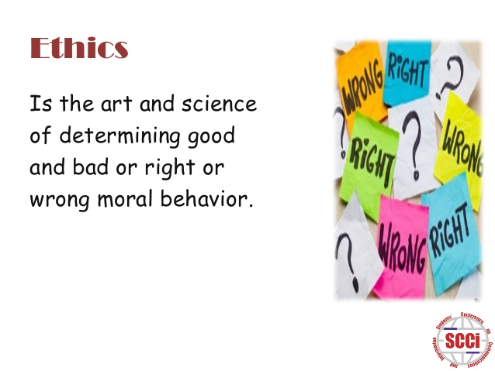

Slide 5
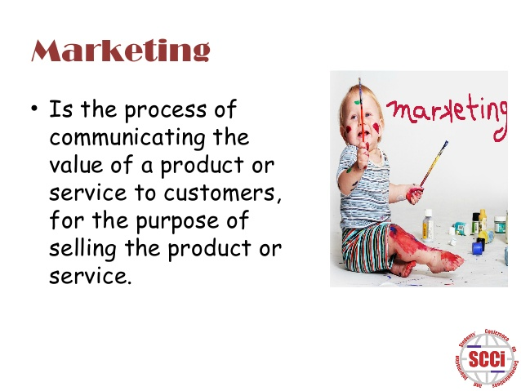

Slide 6
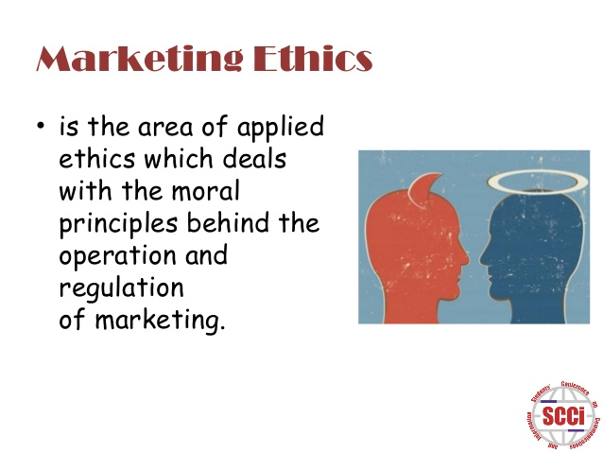

Slide 7


Slide 8
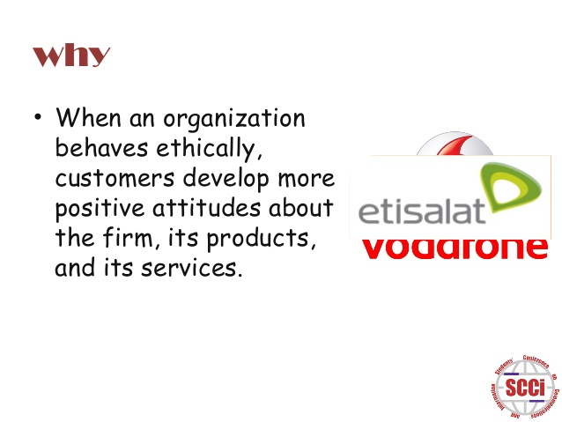

Slide 9
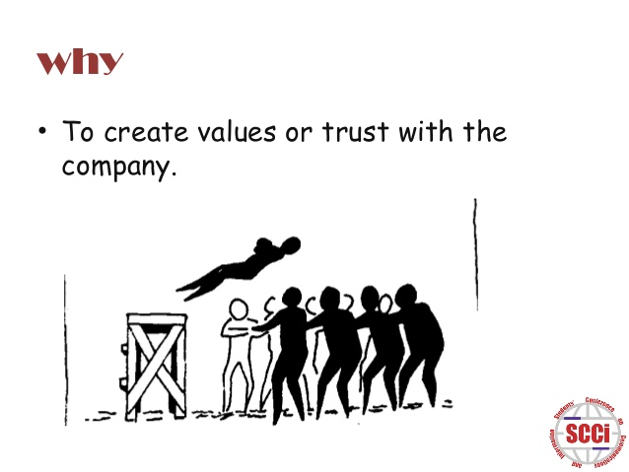

Slide 10
THANK YOU ☺ ☺

